Slide 1



The iot LoRa project
Presentation
AUTHORS : PAUL LELOUP & ZAKARIA EL RHOSN
TUTOR : THIERRY GIL
2019
Notes:
Present my synthesis and state of the art about my end of study industrial project named Study & conception of a smart sensor on fpga. I’m managed by Pascal Benoit, an university lecturer and researcher and i work for help the thesis of Guillaume Patrigeon. The end of study industrial project takes places at LIRMM (Informatic, Robotic and Microelectronic Laboratory)

Slide 2
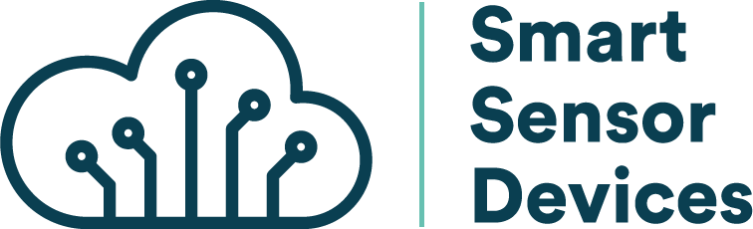
PLAN
Introduction
Fonctionnalities
Hardware
Software
Consumption test
Notes:
First I will introduce the context and the problematic
After that, i will present you the sensors states of the art with the differents interfaces of communication
Next to that, i will speak about the communication states of the art
Before the conclusion and the result, I will present fastly the organisation of the project.

Slide 3
CONTEXTe
Industrial Project of the End of Studies
Radio communication
The French National Centre for Scientific Research (CNRS)
Internet of Things(IOT)
Smart
Sensors
23,14 billion connected devices
Laboratory of Computer Science, Robotics and Microelectronics of Montpellier(LIRMM)
Thesis
Field-Programmable Gate Array (FPGA)
Notes:
LIRMM
Research unity depend of UM and CNRS ( National Center for Scientific Research)
IOTdevices exchanges data
FPGA
Field-Programmable Gate Array
Reconfigurable circuit, change the logic
Standard component, fast time conception and low cost for small series (ex less than 10 000 unity)

Slide 4
Introduction
Research about IoT
Prototypes : The Smart Sensor and the Smart Gateway
Purpose of the project: Measure the consumption and the performance of a connected device for increase it
Differents steps…

Slide 5
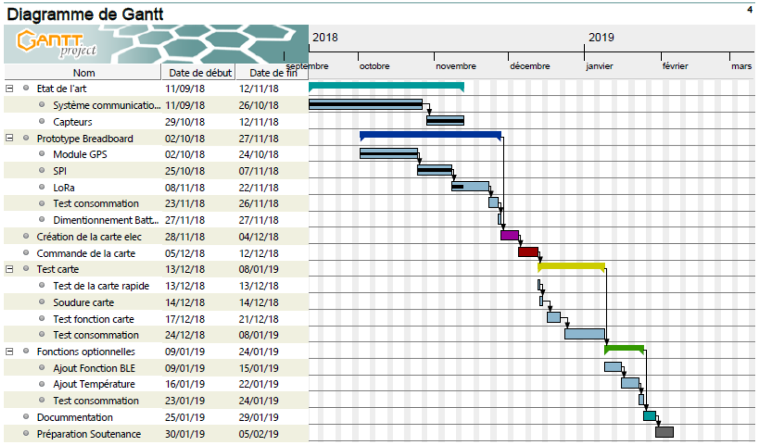
GANTT

Slide 6
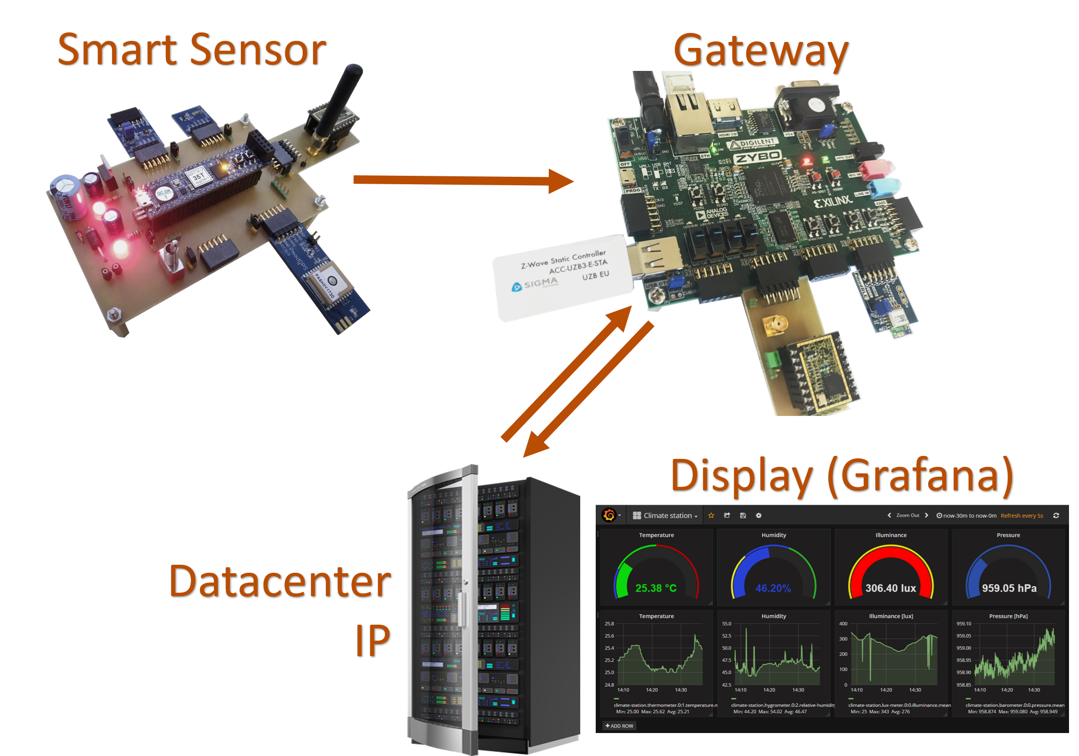
system

Slide 7
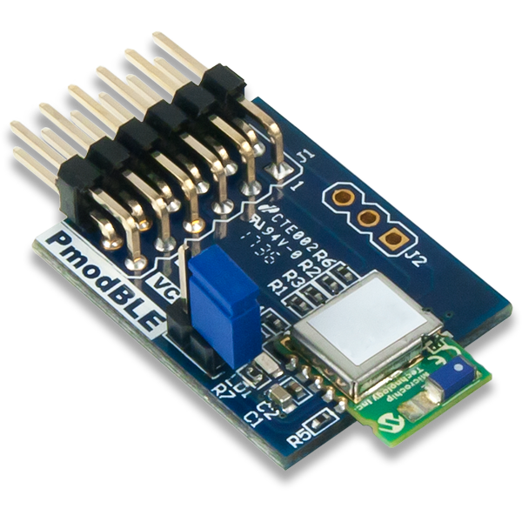
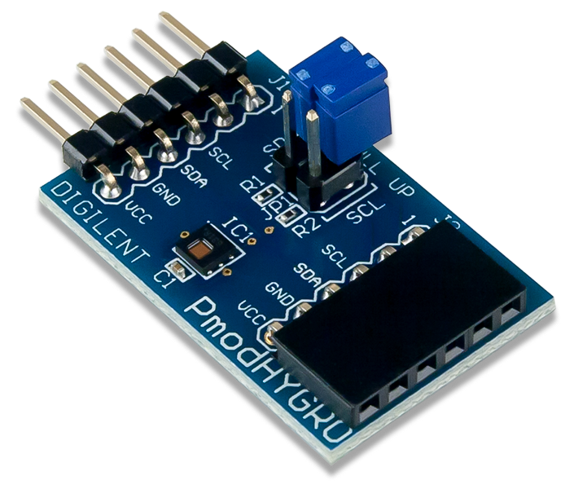
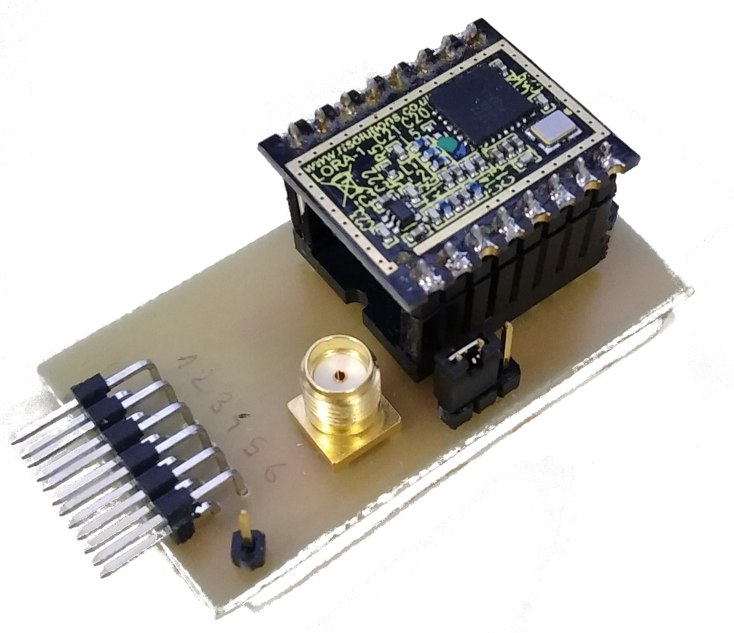
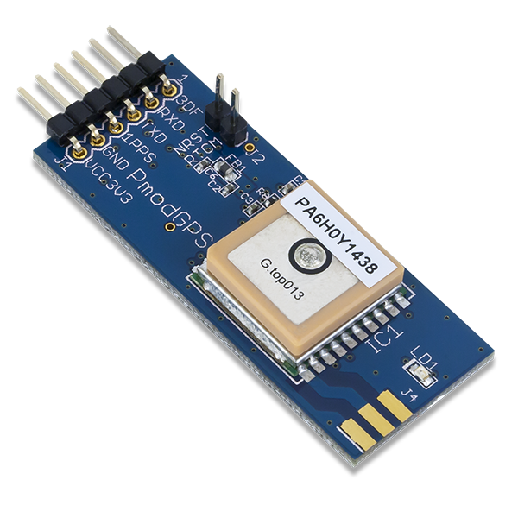
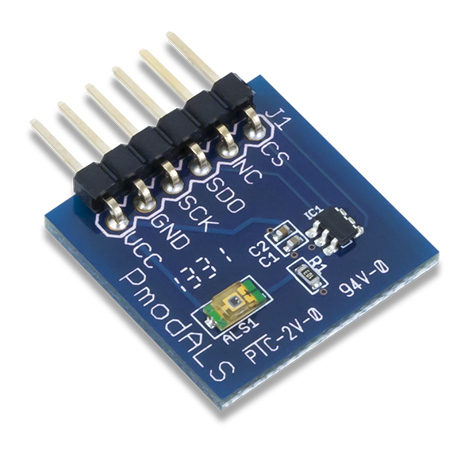
SENSORS AND RADIOS MODULES
Temperature &
Humidity
BLE
LoRa
GPS
Brightness

Slide 8
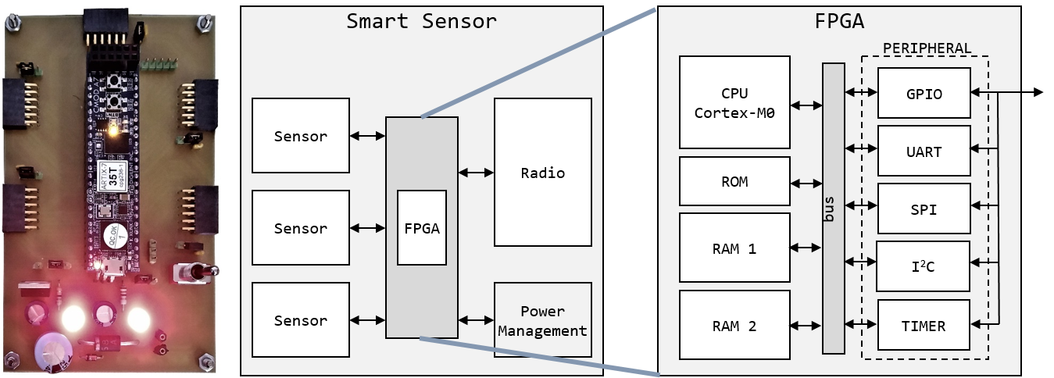
HARDWARE

Slide 9
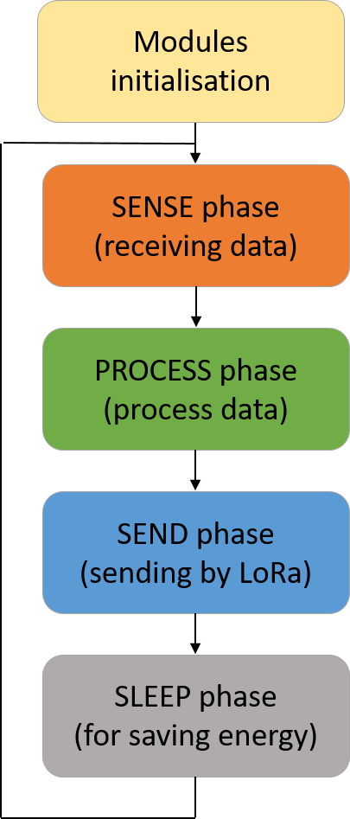
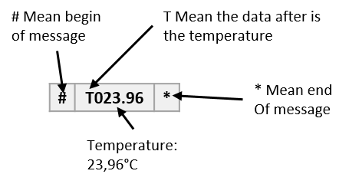
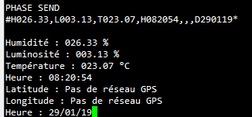
SOFTWARE

Slide 10
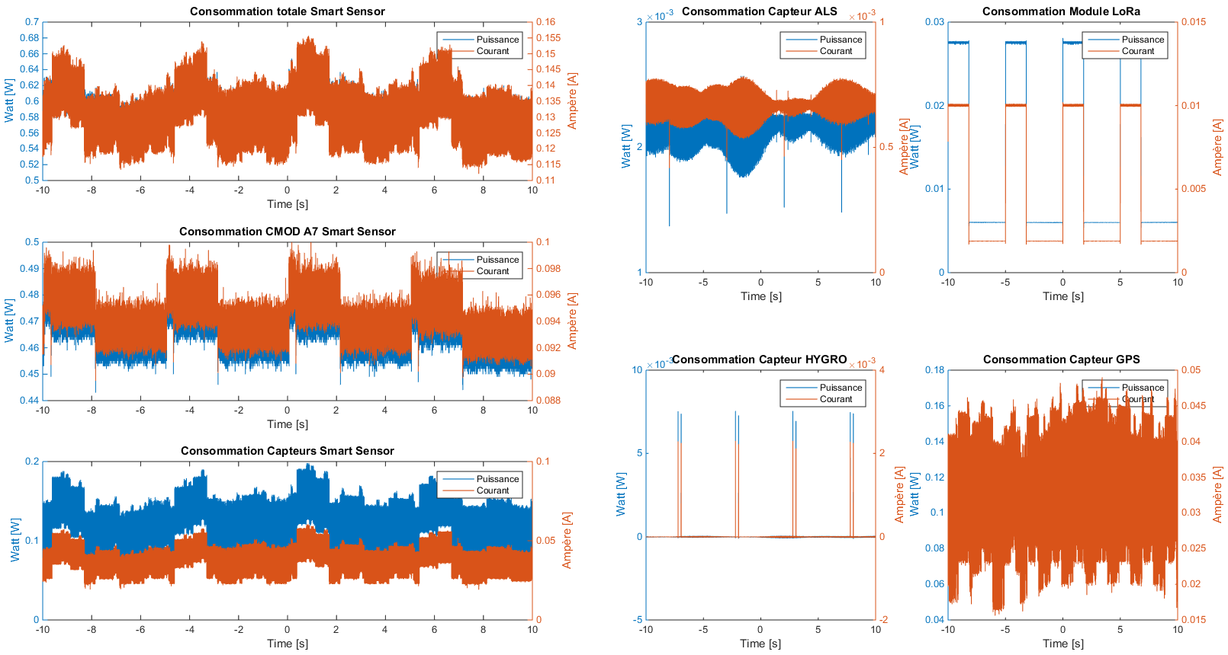
CONSUMPTION TEST

Slide 11
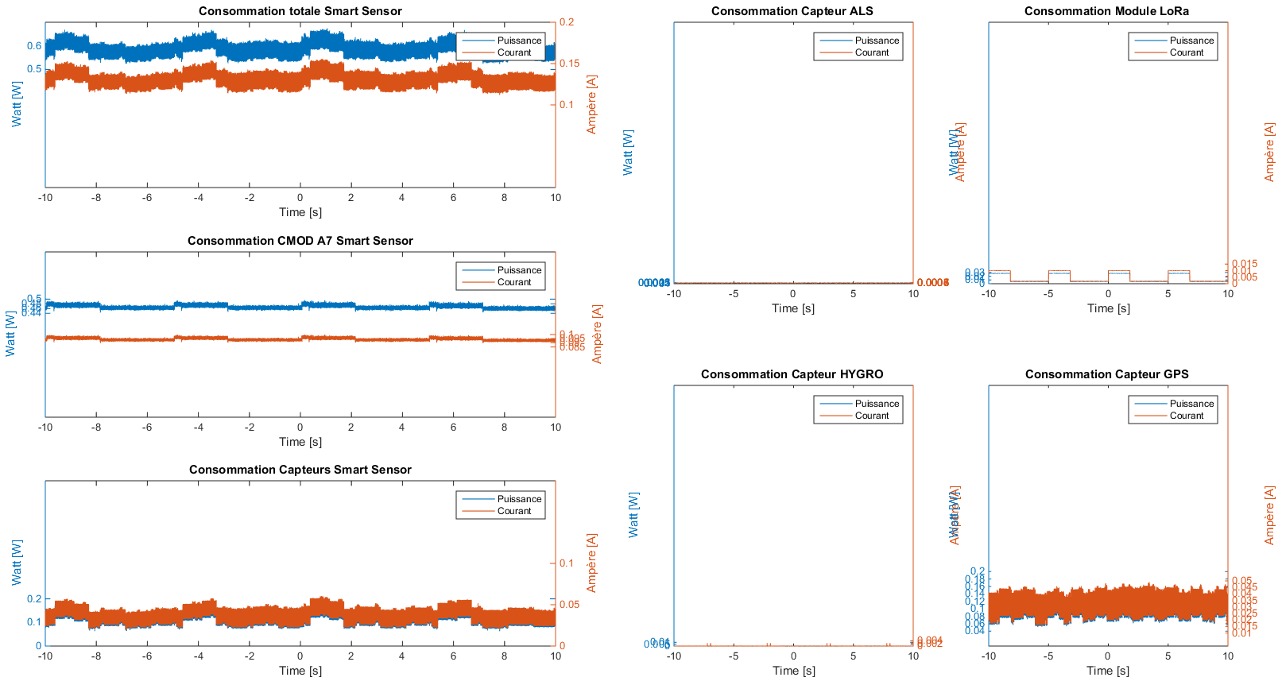
CONSUMPTION TEST

Slide 12
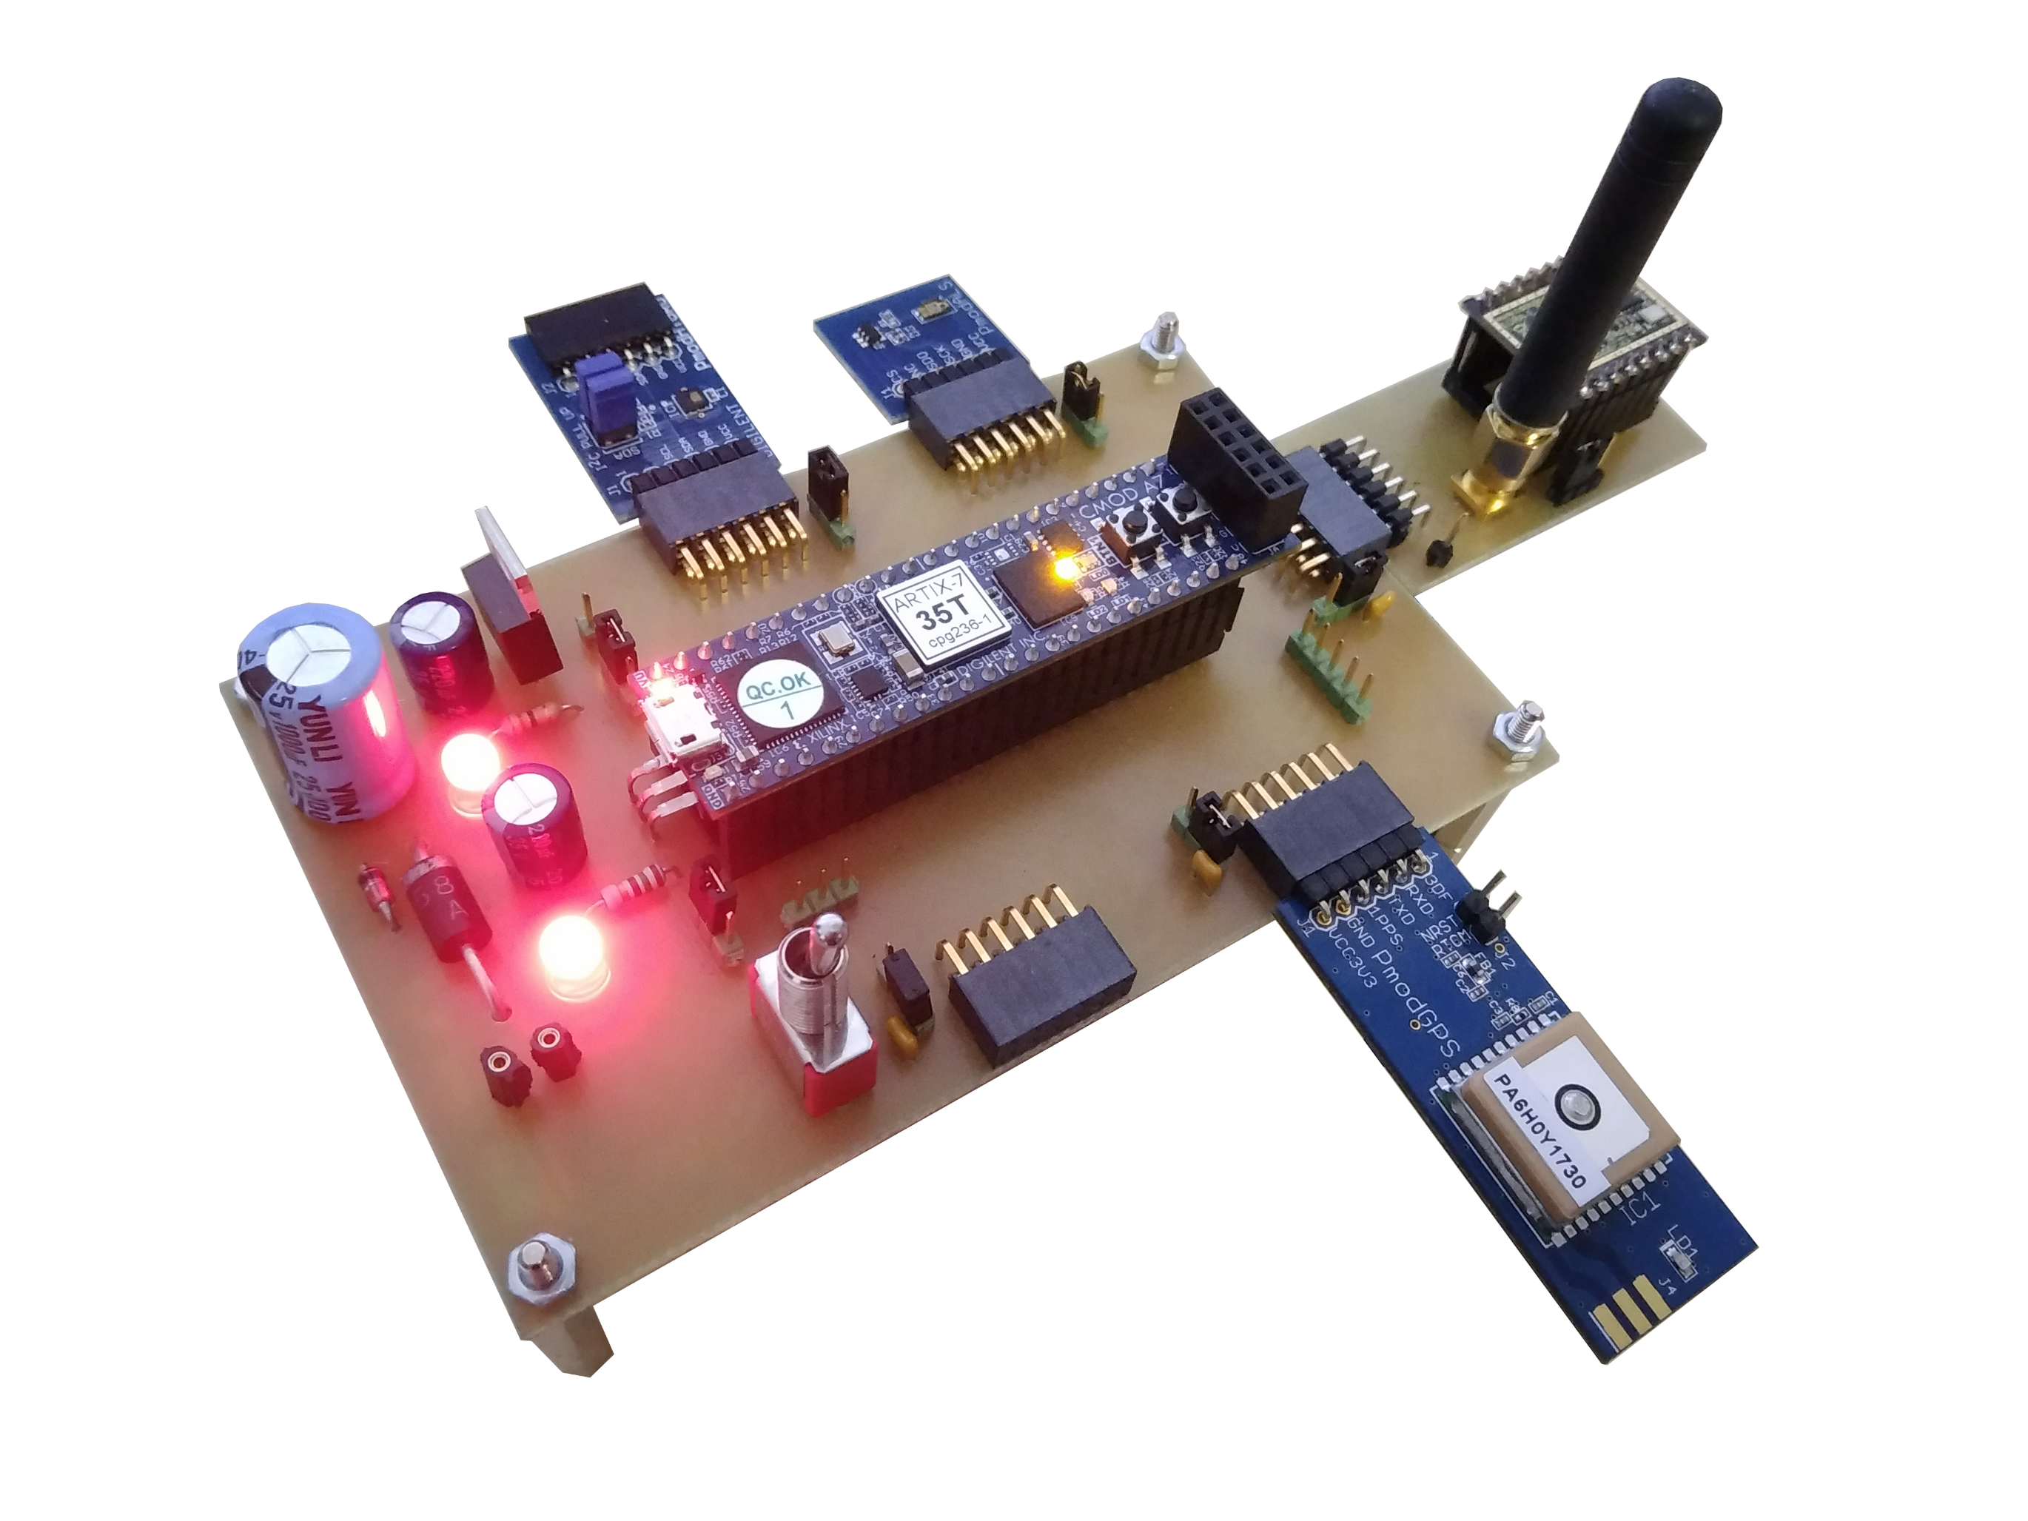
CONCLUSION

